Slide 1
Neuro Navigation SlicerIGT tutorial 2022
brain surgery navigation with live tractography
for 3D Slicer version 5.0.2

Slide 2
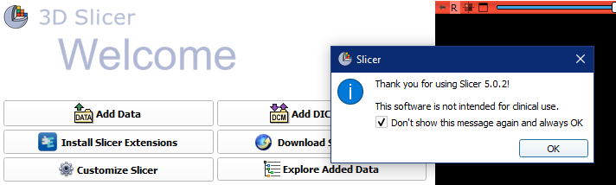
Install Slicer
Visit http://download.slicer.org/
Download Slicer version 5.0.2 (blue buttons) for your operating system
Run the downloaded installer
Start up Slicer
1

Slide 3
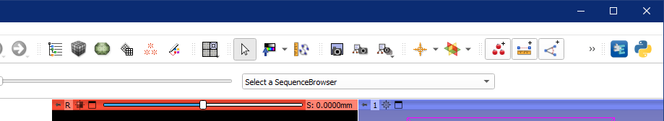
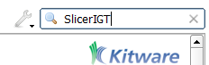
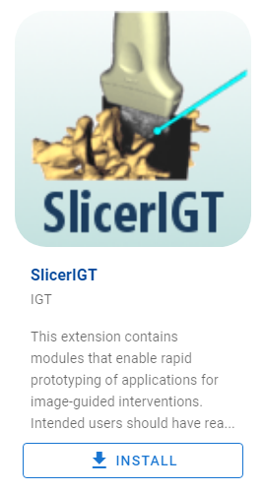
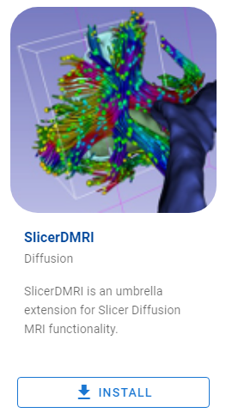
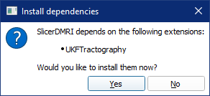
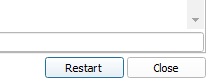
Install Slicer extensions
1. click
2. Find and install these extensions: SlicerIGT, SlicerDMRI
5. click
6. click
3. click
4. click

Slide 4
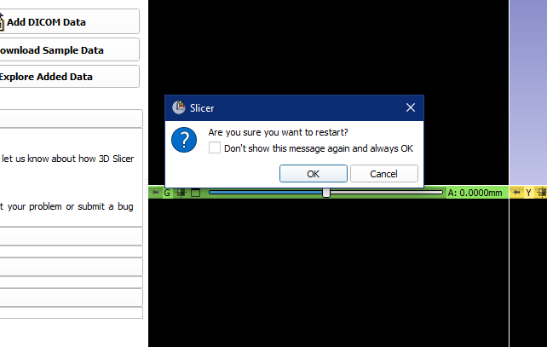
Approve restart of Slicer (if asked)
1. click

Slide 5
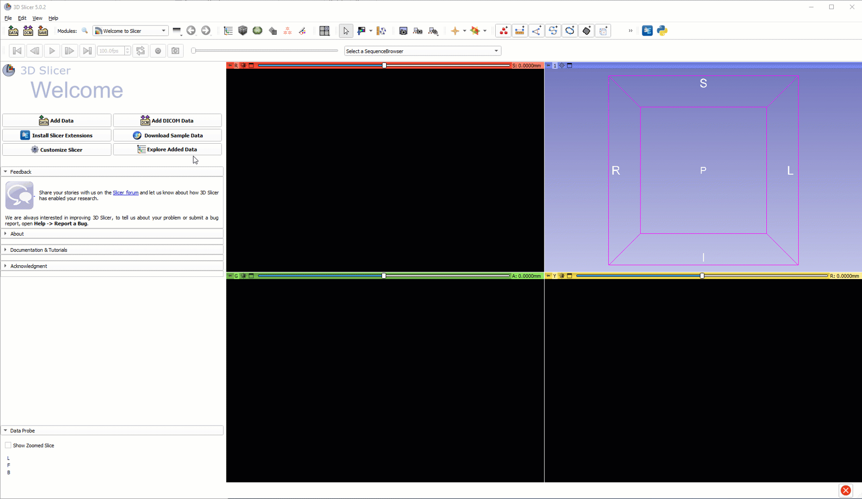
Verify extensions installed

Slide 6
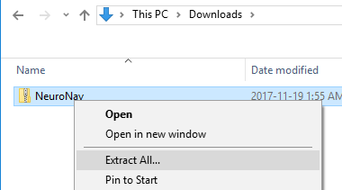
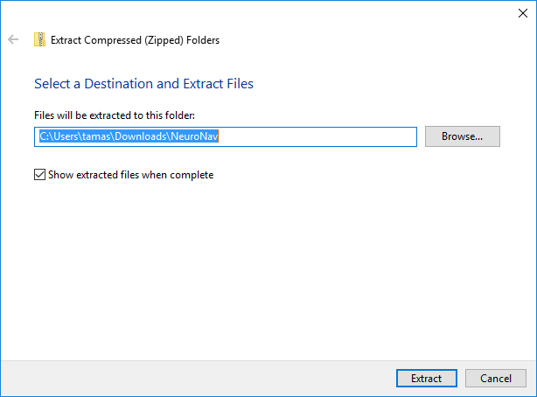
Unzip tutorial data folder
1. click
2. click

Slide 7
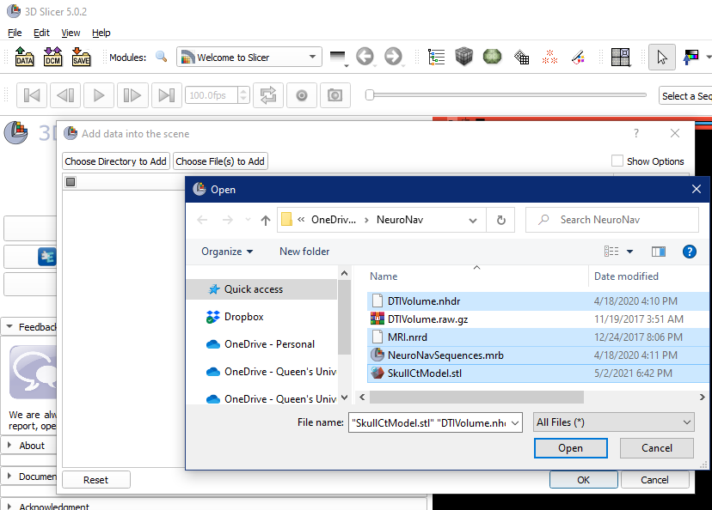
1
2
2
2
2
2
3

Slide 8
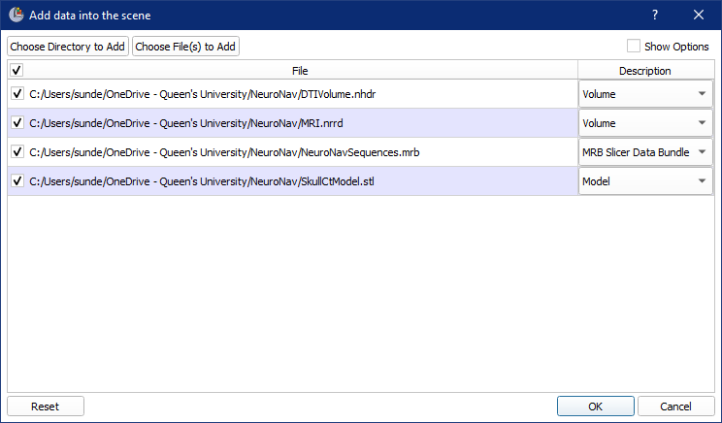
1

Slide 9
About the loaded data
SkullCtModel.stl: Segmentation from CT scan of a plastic skull model
MRI.nrrd: Magnetic resonance image of a person. (not the same one the plastic model was based on)
DTIVolume.nhdr: Diffusion tensor image (from a third person)
NeuroNavSequences.mrb: Time sequences for replaying tool motions
All image volumes are already registered roughly (they more or less overlap, but they come from different patients, so the overlap is not perfect)

Slide 10
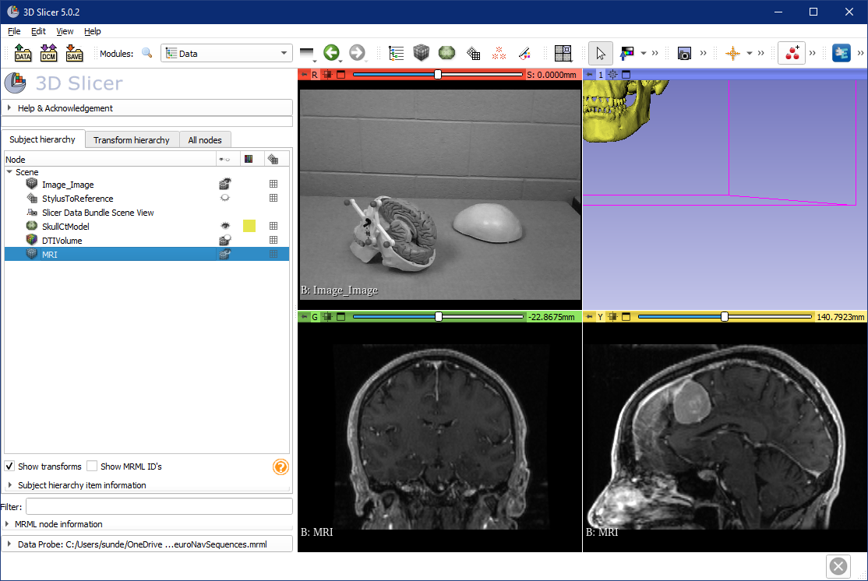
1. click
2. Drag & drop Image_Image
3. Drag & drop MRI
4. Drag & drop MRI

Slide 11

3
1
2

Slide 12
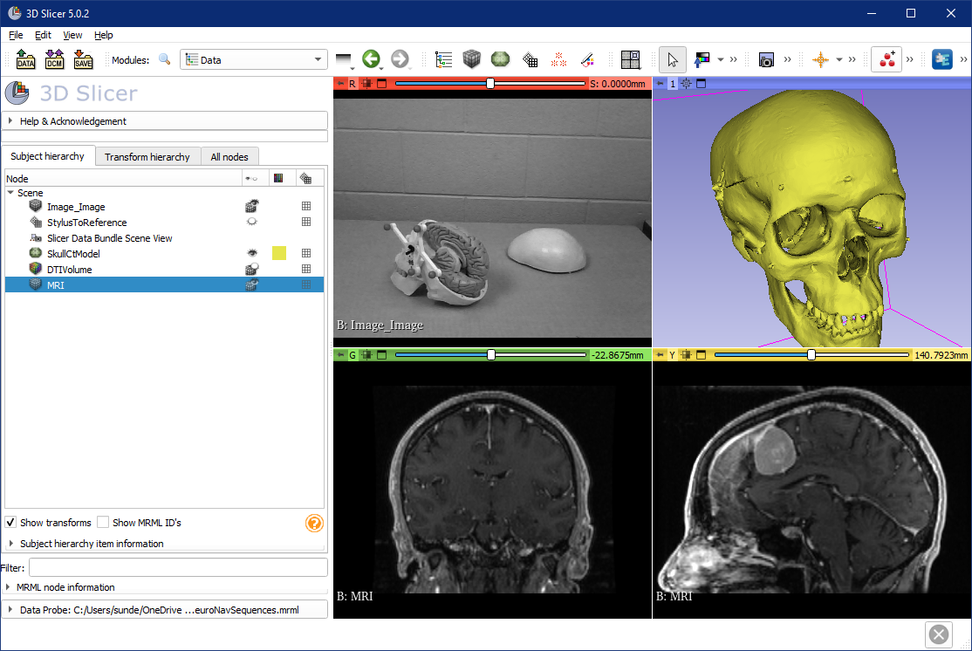
Try 3D interactions
Mouse left button drag – rotations
Mouse wheel – zoom
Mouse middle button drag – panning
Try 2D interactions
Mouse wheel – change slice
Mouse right button drag – zoom
Mouse middle button drag – panning
Mouse left button drag – intensity windowing

Slide 13
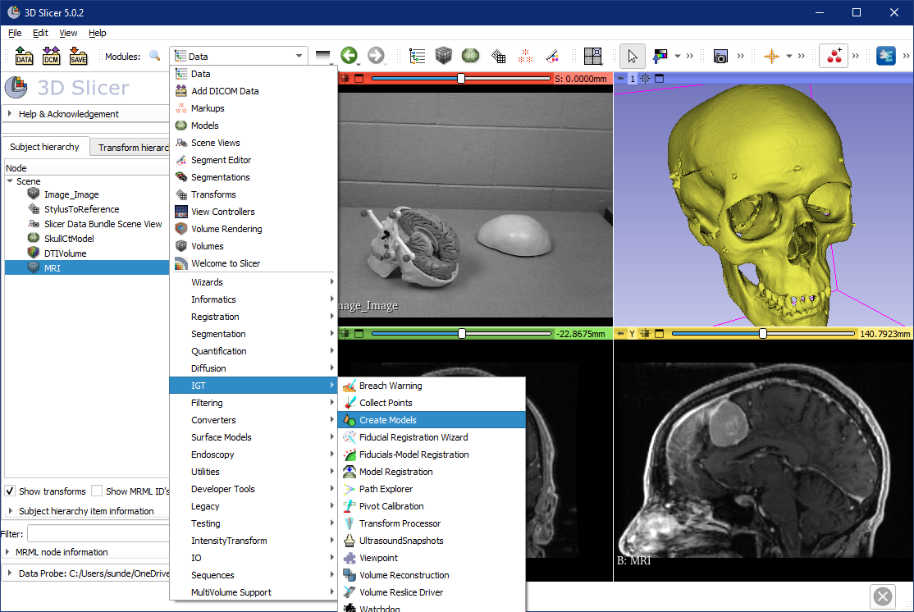
1
2
select

Slide 14
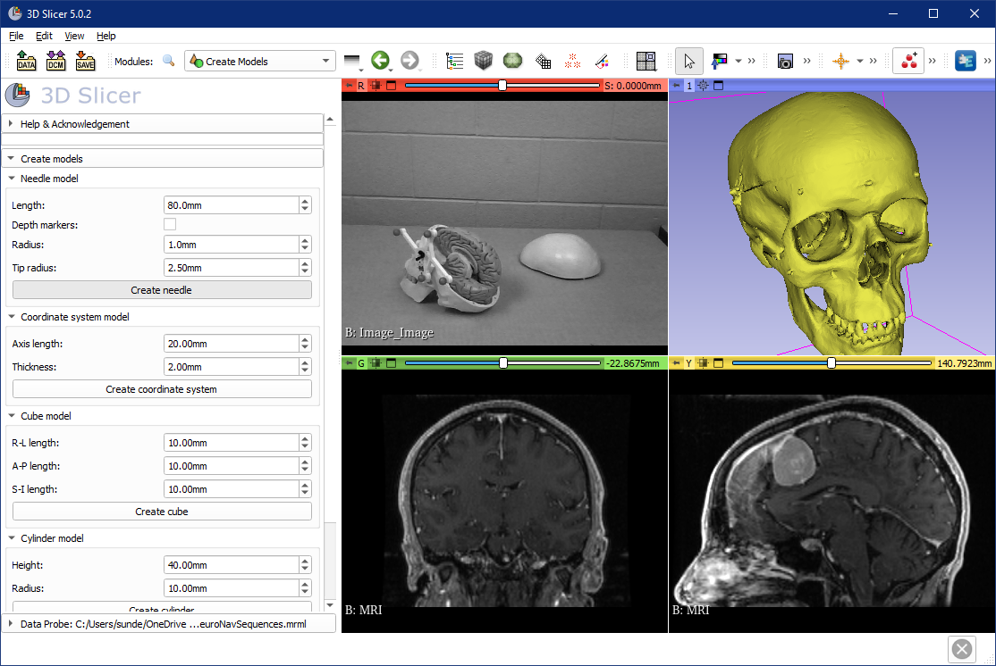
1. see
2. Press once
You won’t see anything when you click, but don’t worry, the needle model is created.

Slide 15
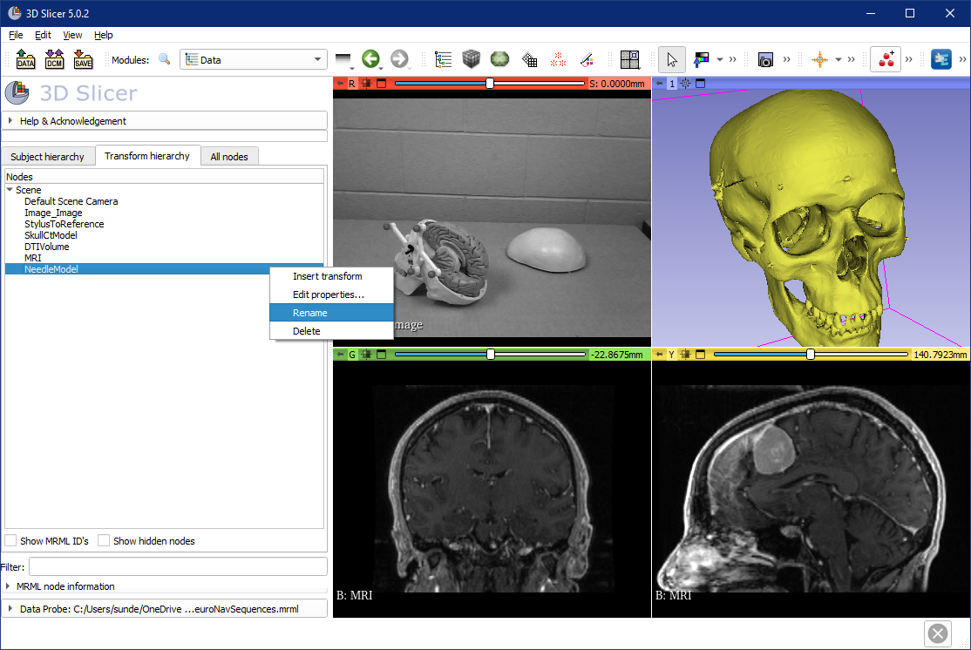
2. see
1
3
4. Right click
5
6. Rename to “StylusTip”

Slide 16
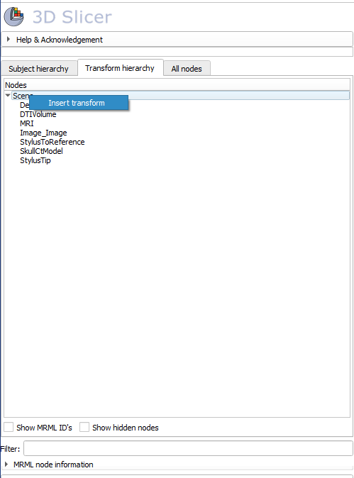
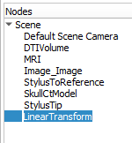
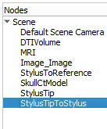
1. Right-click on Scene
2
3. Double-click to rename new transform
4. Name it StylusTipToStylus

Slide 17
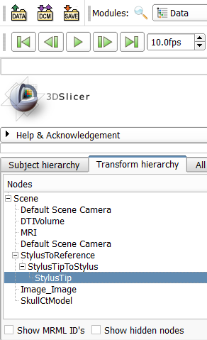
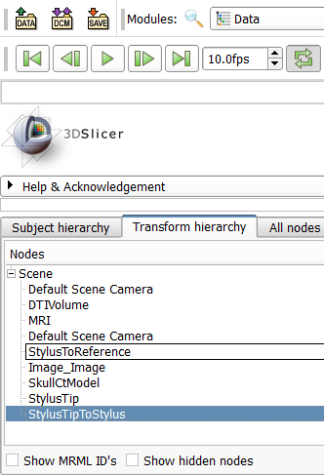
2. Drag and drop until the transform hierarchy looks like this
1. Drag and drop transformable nodes to create transform hierarchy

Slide 18
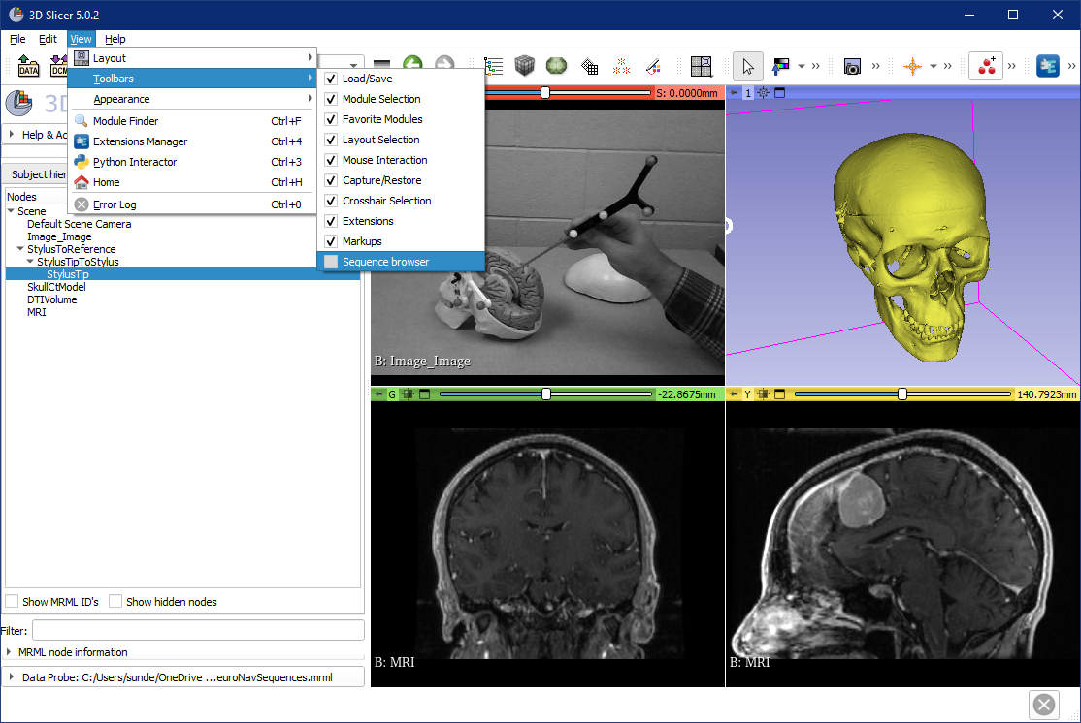
1
2
3

Slide 19
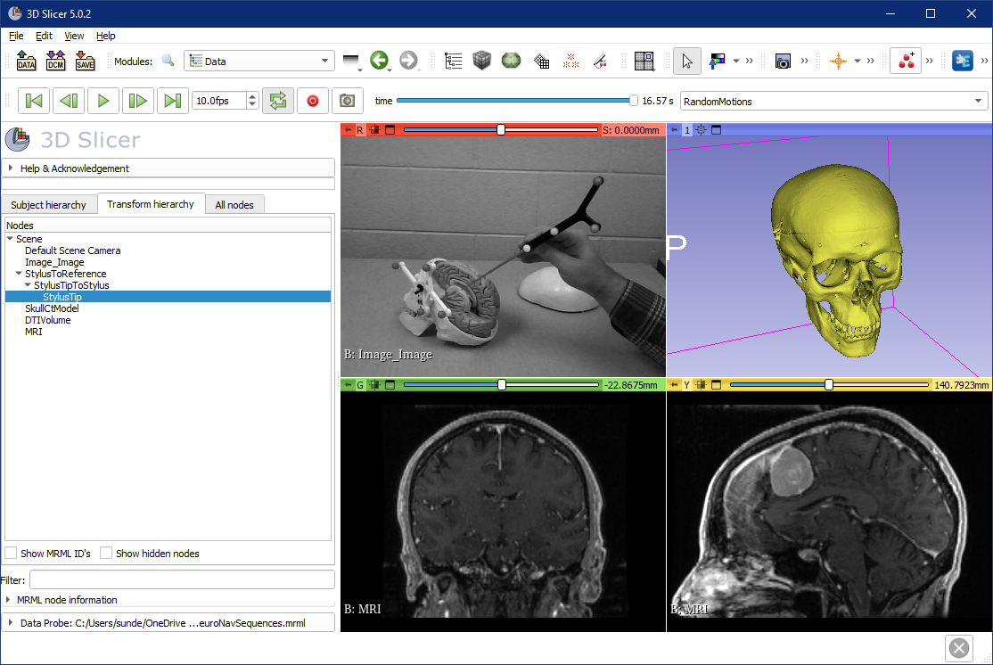
You can drag and drop the position of the toolbar grabbing this grey vertical bar. Putting it in a new line gives it more space.

Slide 20
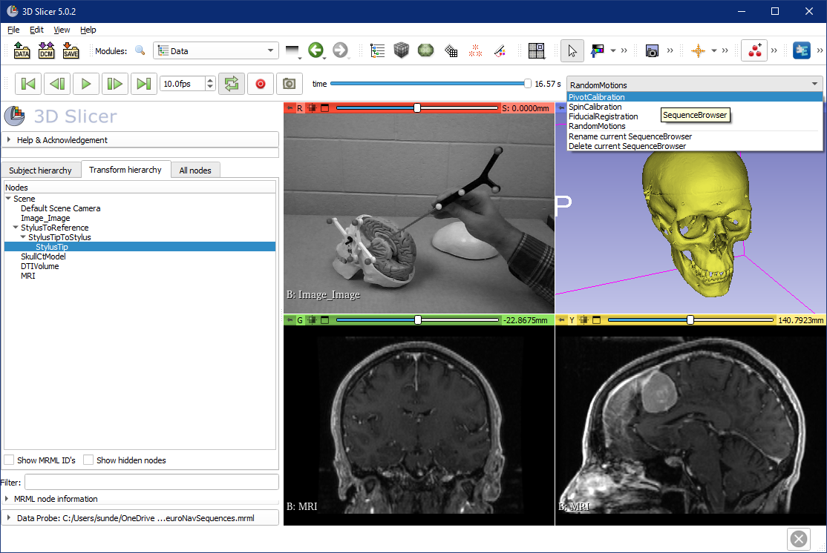
1

Slide 21
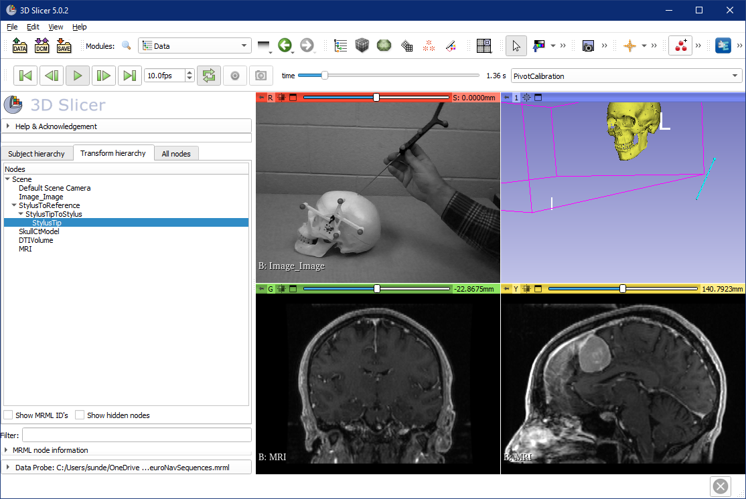
1
2. Zoom out and rotate to see the blue stick (StylusTip) move

Slide 22
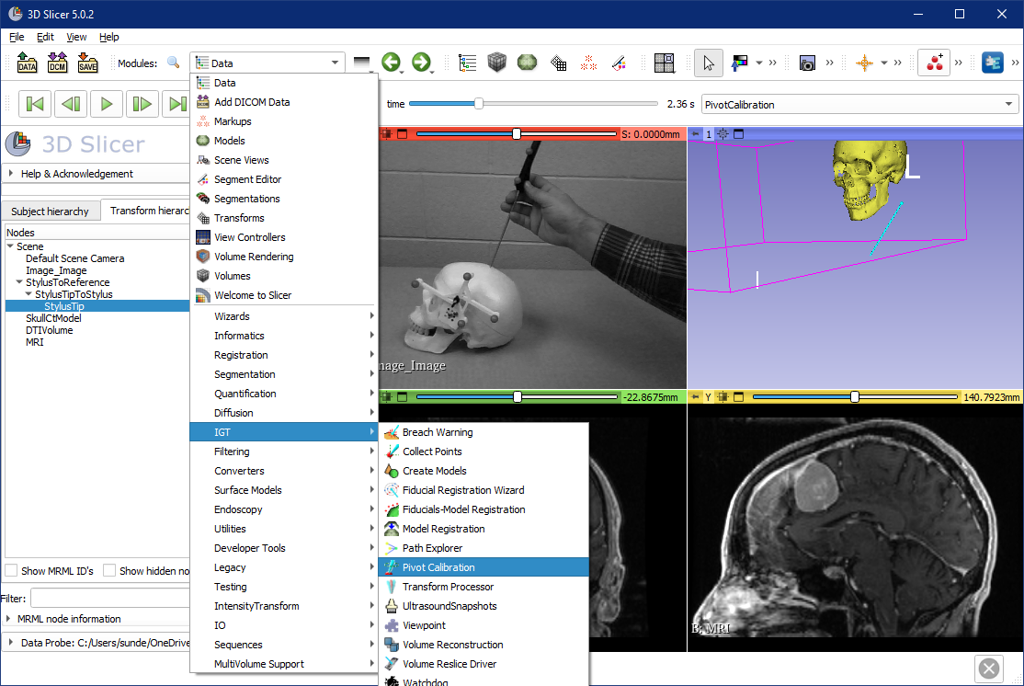
1
2
3. select

Slide 23
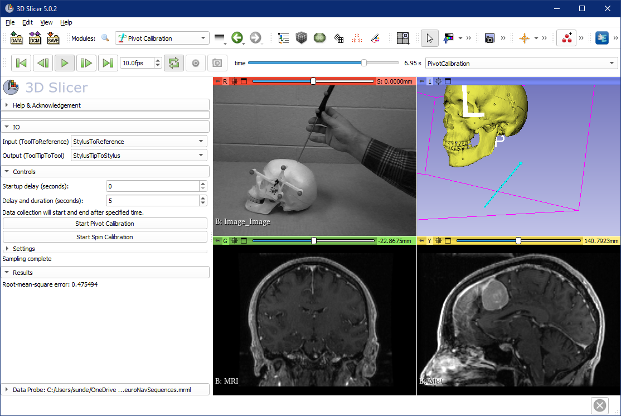
1
5. see: tip position should remain roughly stable
2
3. (optional)
4. then wait 5 seconds
6. Check RMSE

Slide 24
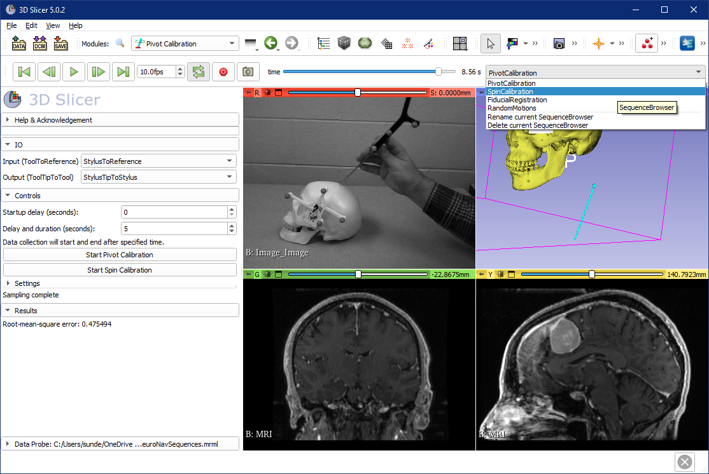
1. pause
2

Slide 25
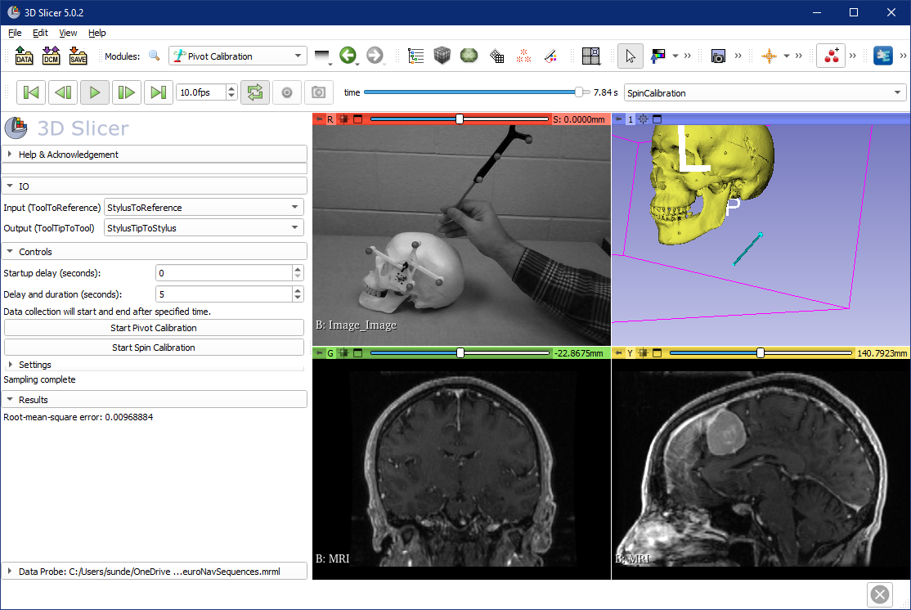
1. play
3. StylusTip direction remain roughly stationary
2
4. Check RMSE

Slide 26
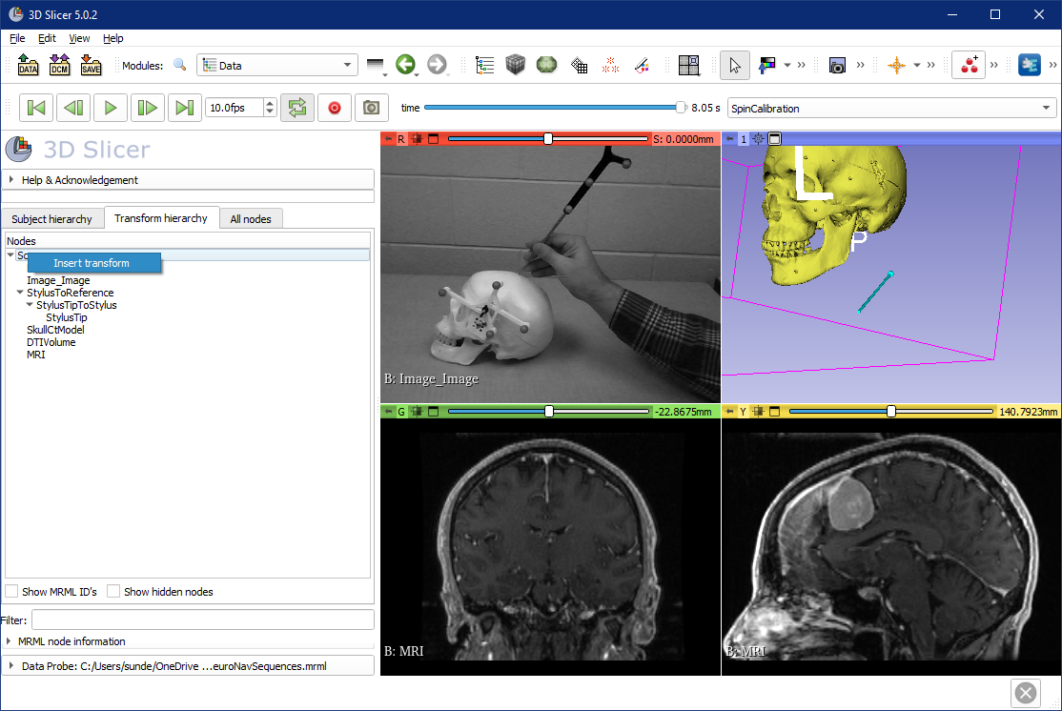
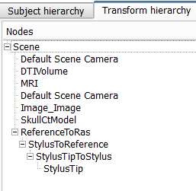
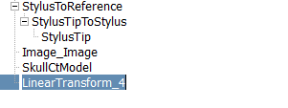
2
1. pause
2 right-click
3
6. Drag and drop StylusToReference to create this new hierarchy
4. Double-click to rename to “ReferenceToRas”
RAS is the coordinate system of the Slicer views

Slide 27
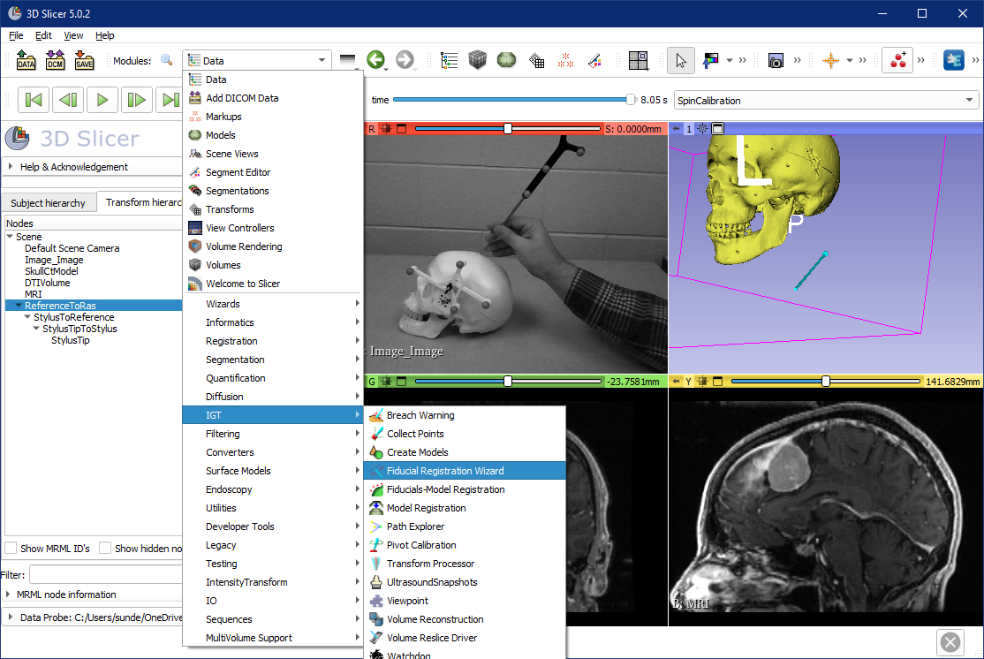
1
2
3. select

Slide 28
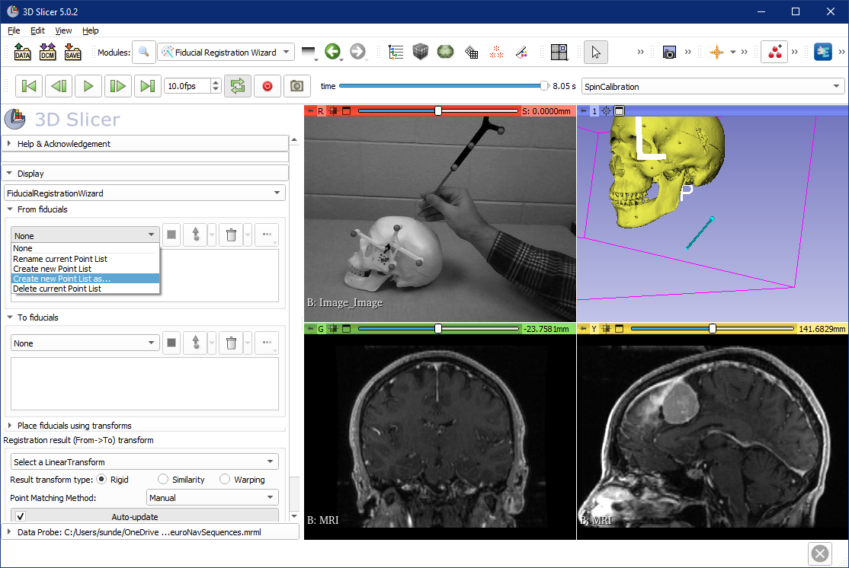
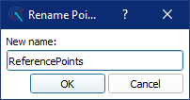
1
2
3
4

Slide 29
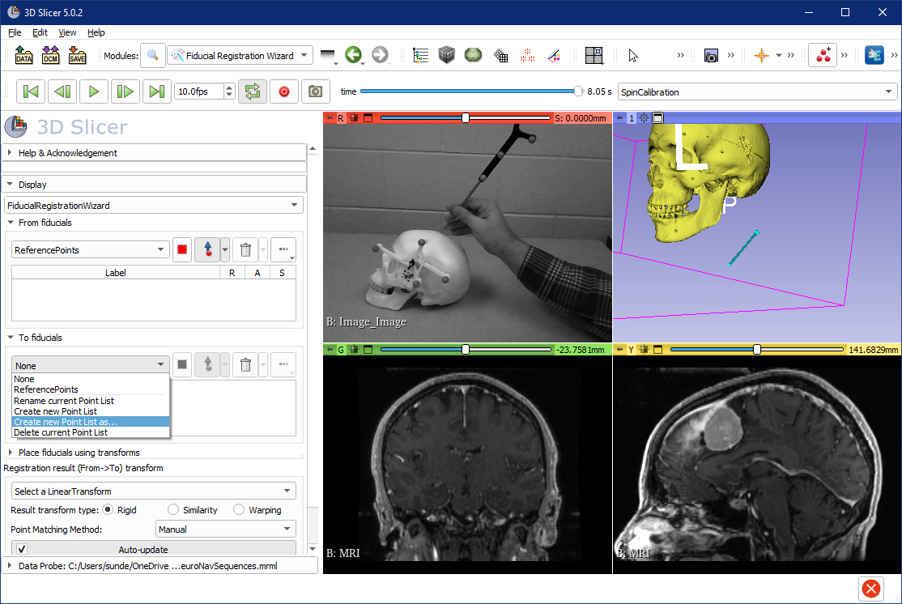
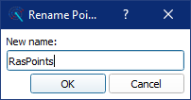
3
1
4
2

Slide 30
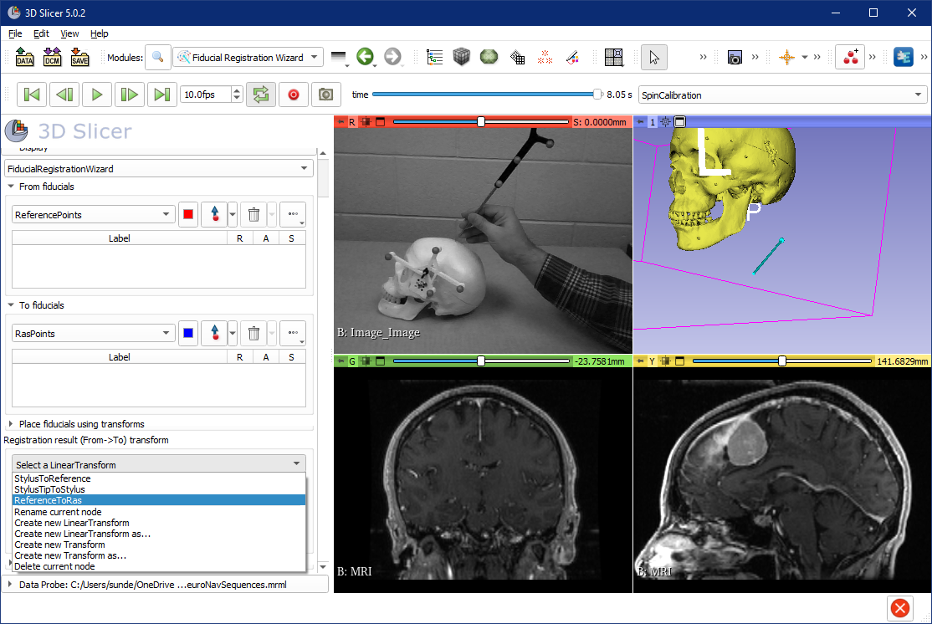
1. Maybe need to scroll down to see “result”
2
3. select ReferenceToRas

Slide 31
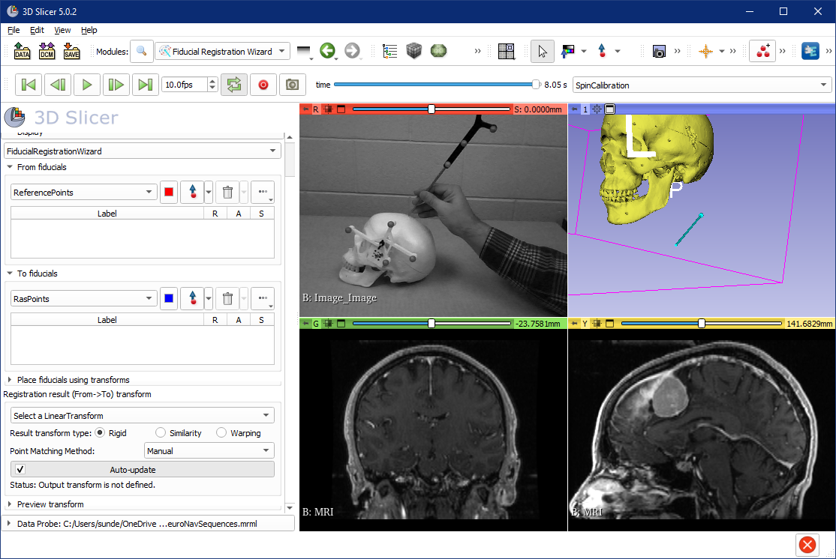
1. Make sure these buttons are unchecked when interacting with 3D viewer!
2. Maximize 3D view

Slide 32
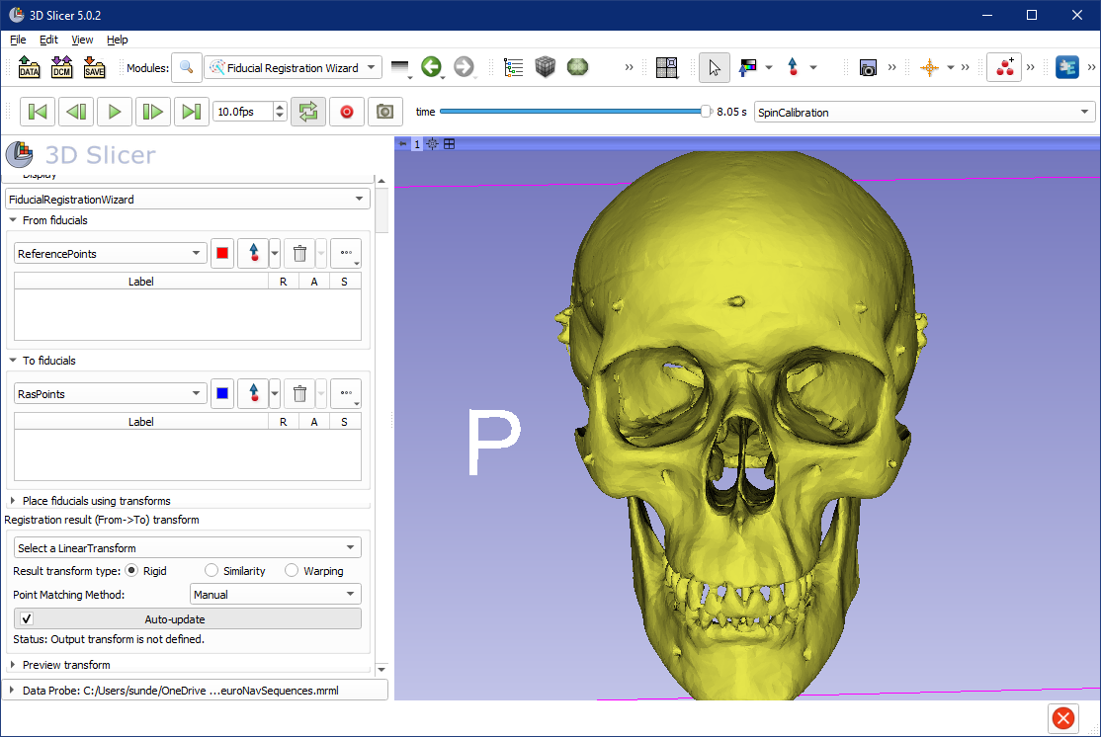
1. Set up 3D viewer like this to see the front of the skull
3. click here
2

Slide 33
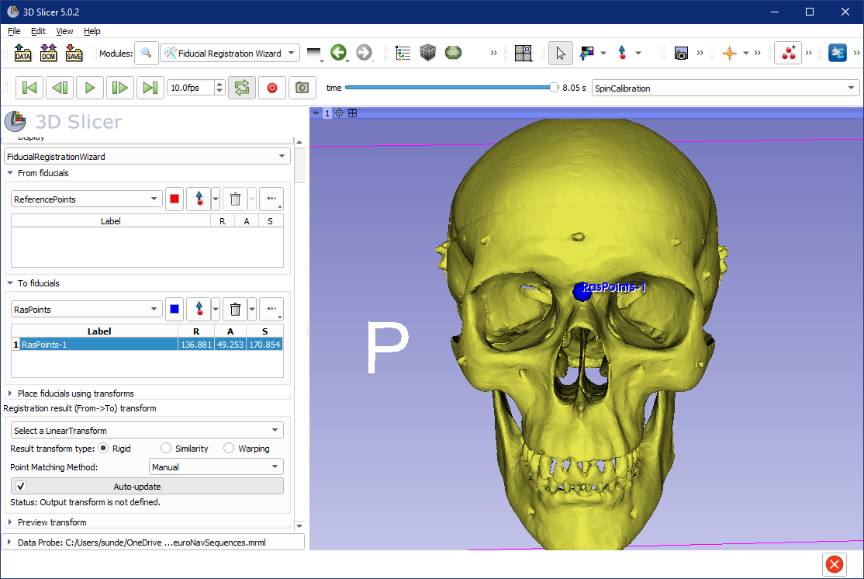
Notice blue point created
Notice point added to list

Slide 34
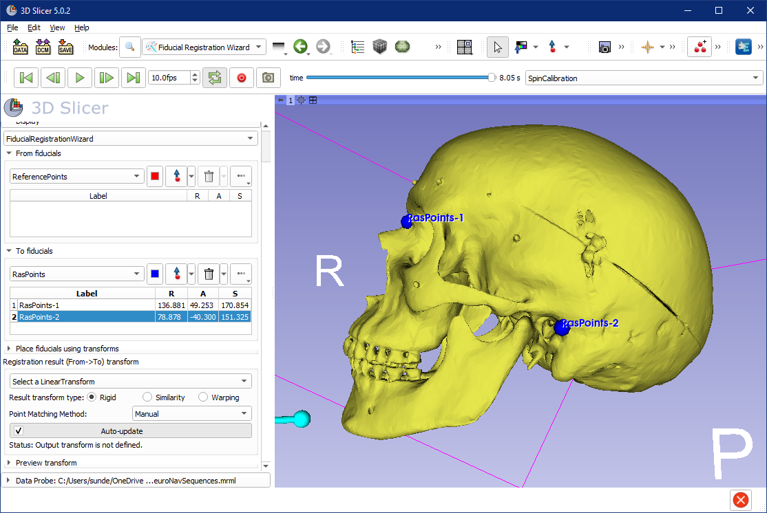
1. Similarly, create the second point here

Slide 35
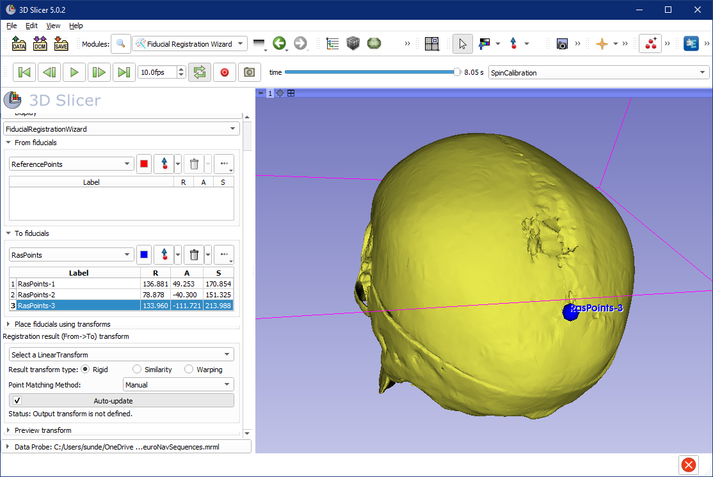
1. And the third one here

Slide 36
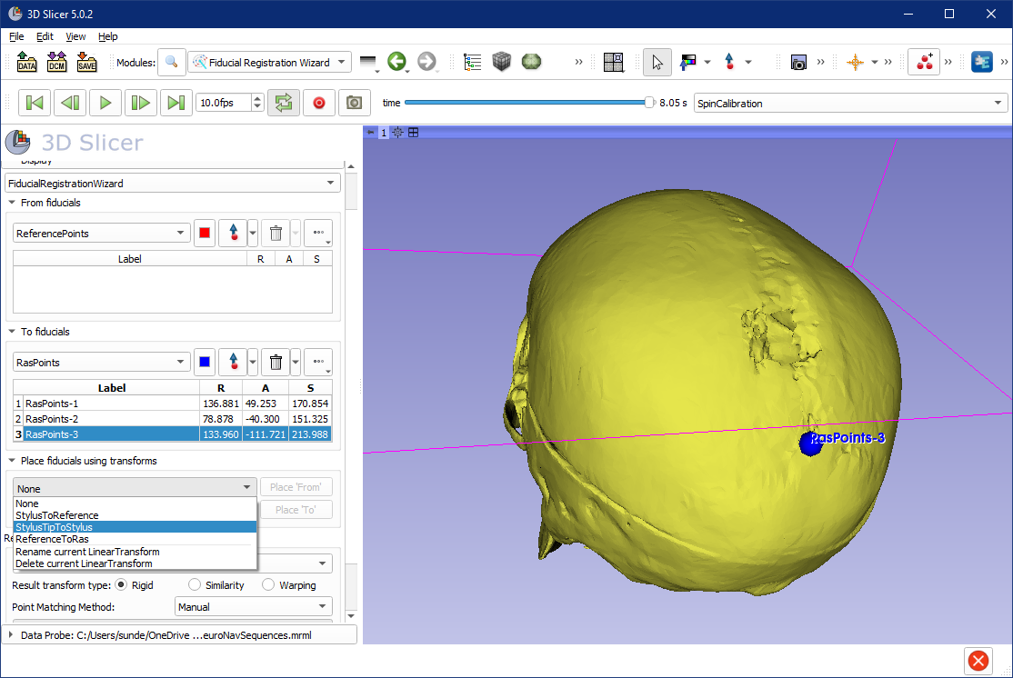
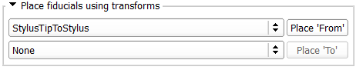
Note: When you press Place ‘From’,
a new point will be created in
the From list at the position of the StylusTip
1. Expand Place box
2. Select StylusTipToStylus in upper (From) selector

Slide 37
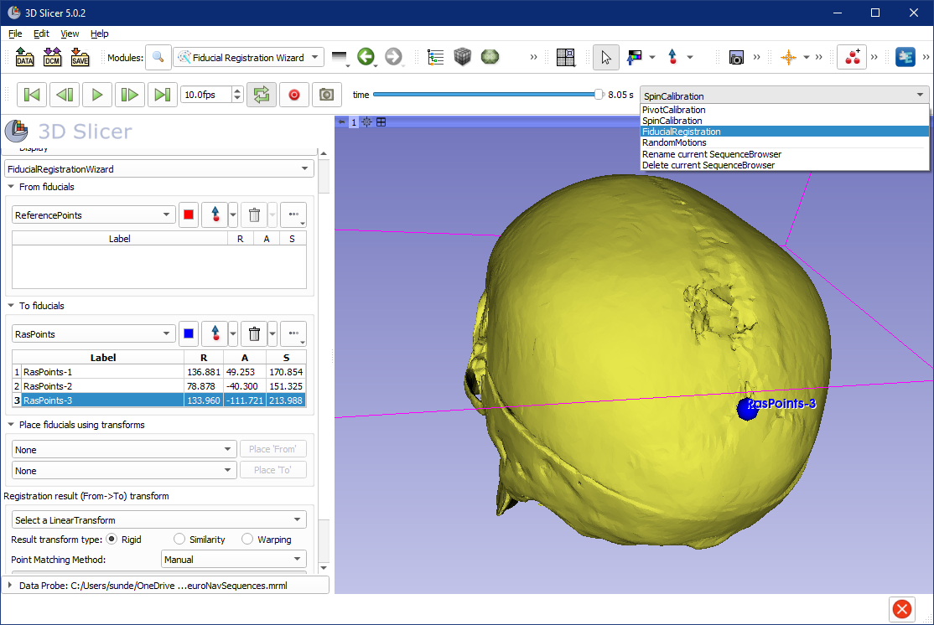
3. play
2
1

Slide 38
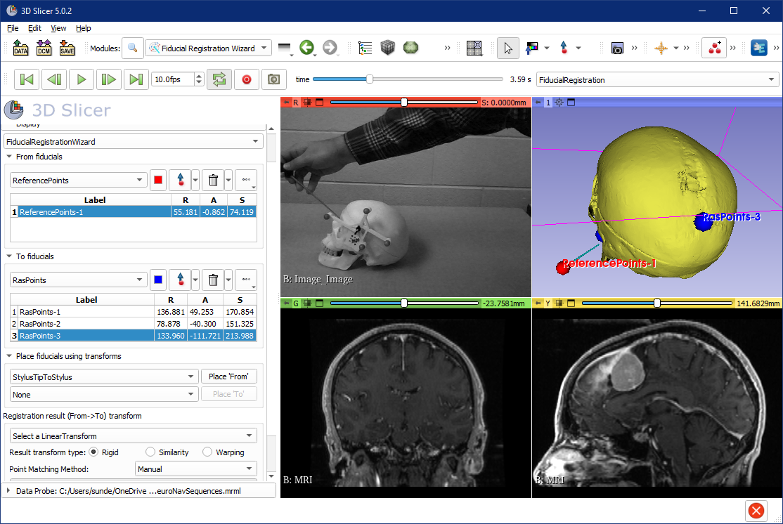
1
Scroll time to the point where the stylus on the video points to the first registration point
1
3. see
2

Slide 39
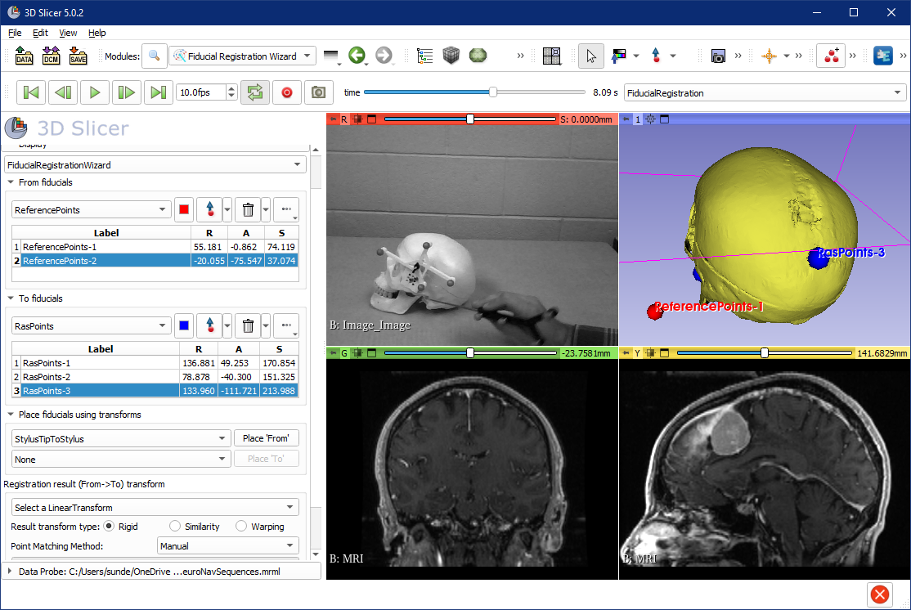
1
1
3. see
2

Slide 40

1
3. see
1
4. see
2
5. uncheck

Slide 41



Troubleshooting
How to redo one point (before registration completed)
Delete
How to reset registration (after a completed registration)
2. see
1
Very important to reset to Identity before starting a new registration!
3

Slide 42

2. Volume Reslice Driver

Slide 43

1. select yellow driver node

Slide 44

1. select green driver node

Slide 45

4. Move
3
1
2

Slide 46

1
2. select
4. see
4. see
3. scroll down to see this option and check it

Slide 47

1. module history
2. Back to Volume Reslice Driver

Slide 48

These advanced view options are used to set up viewers in a way that navigation is intuitive for the surgeon. E.g. stylus movement to the left results stylus model movement to the left in the viewers
2
3
1

Slide 49

1
2

Slide 50

1
2. click anywhere
3. double-click each coordinate and set to zero

Slide 51

1
2. drag and drop “F” here
Result: overlapping red point

Slide 52

1
2. double-click
3
4

Slide 53

1

Slide 54

Tractography Seeding

Slide 55

4
1
see result
2
3

